Slide 1
Models of Development

Slide 2
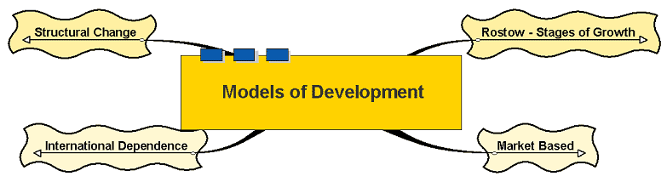
Models of Development

Slide 3
Models of Development
How do countries develop?
If we can understand how development occurs, strategies can be adopted to help countries to develop
Number of approaches:

Slide 4
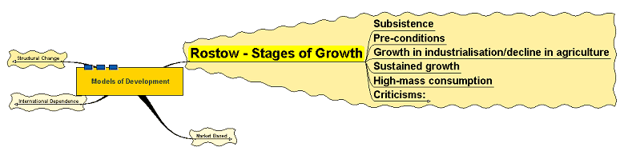
Rostow - Stages of Growth

Slide 5
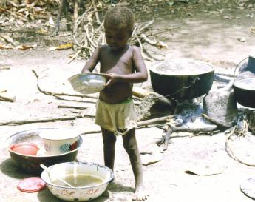
Rostow - Stages of Growth
The work of American Walt W. Rostow
Rostow is an economic historian
Countries can be placed in one of five categories in terms of its stage of growth:
A child in Sierra Leone making breakfast. Which stage would a country like Sierra Leone fit in?
Copyright: Dave Dyett, http://www.sxc.hu/

Slide 6
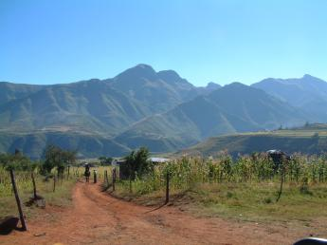
Rostow - Stages of Growth
Traditional Society
Characterised by
  subsistence economy – output not traded or recorded
  existence of barter
  high levels of agriculture and labour intensive agriculture
Village in Lesotho. 86% of the resident workforce in Lesotho is engaged in subsistence agriculture.
Copyright: Tracy Wade, http://www.sxc.hu/

Slide 7
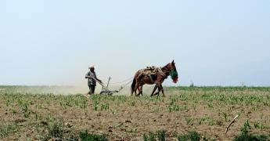
Rostow - Stages of Growth
2. Pre-conditions:
  Development of mining industries
  Increase in capital use in agriculture
  Necessity of external funding
  Some growth in savings and investment
The use of some capital equipment can help increase productivity and generate small surpluses which can be traded.
Copyright: Tim & Annette, http://www.sxc.hu

Slide 8
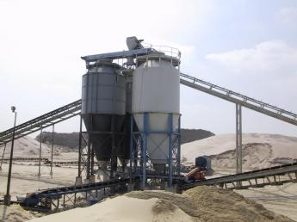
Rostow - Stages of Growth
3. Take off:
  Increasing industrialisation
  Further growth in savings and investment
  Some regional growth
  Number employed in agriculture declines
At this stage, industrial growth may be linked to primary industries. The level of technology required will be low.
Copyright: Ramon Venne, http://www.sxc.hu

Slide 9

Rostow - Stages of Growth
4. Drive to Maturity:
  Growth becomes self-sustaining – wealth generation enables further investment in value adding industry and development
  Industry more diversified
  Increase in levels of technology utilised
As the economy matures, technology plays an increasing role in developing high value added products.
Copyright: Joao de Freitas, http://www.sxc.hu

Slide 10
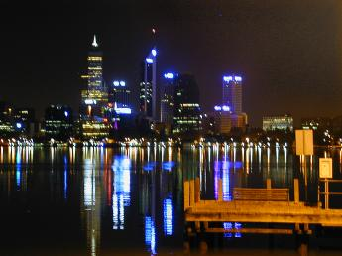
Rostow - Stages of Growth
5. High mass consumption
  High output levels
  Mass consumption of consumer durables
  High proportion of employment in service sector
Service industry dominates the economy – banking, insurance, finance, marketing, entertainment, leisure and so on.
Copyright: Elliott Tompkins, http://www.sxc.hu

Slide 11
Criticisms:
Too simplistic
Necessity of a financial infrastructure to channel any savings that are made into investment
Will such investment yield growth? Not necessarily
Need for other infrastructure – human resources (education), roads, rail, communications networks
Efficiency of use of investment – in palaces or productive activities?
Rostow argued economies would learn from one another and reduce the time taken to develop – has this happened?

Slide 12
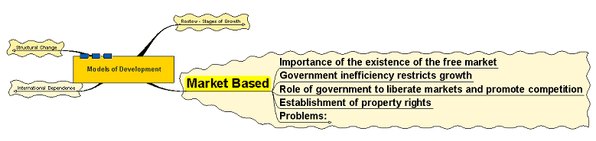
Market Based

Slide 13
Market Based
Development is determined by the extent to which the market is able to allocate resources
The price signal acts to allocate scarce resources
Governments limit interference in the working of the economy
Government role is to encourage enterprise and to reduce regulation and inefficiencies in free markets and establish ownership of property rights

Slide 14
Problems:
Existence of market failure – externalities, monopoly power, public goods
Problems of lack of infrastructure – education and health, public transport, legal structure
Problems of equity in allocation – wealth and income distribution

Slide 15
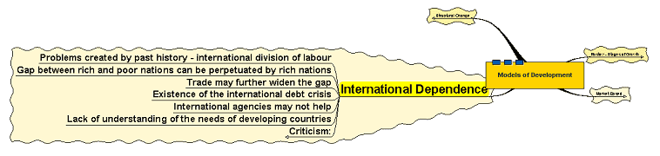
International Dependence

Slide 16
International Dependence
International division of labour – rich in high value activity, poor in low value, can be traced back to colonial and imperial dominance
Dominance of political decision making in the hands of a few wealthy and powerful groups who aim to maintain the status quo
Such interest groups also exercise power over international institutions and initiatives such as the World Trade Organisation, International Monetary Fund, Kyoto talks, etc.

Slide 17

International Dependence
Advice given to poorer nations has been poor – e.g. lending to less developed countries, investment advice, etc.
Inability to solve the debt crisis and protectionism continues to prevent development of poorest countries
The International Dependence model can perhaps be exemplified by the lack of progress on reducing emissions to restrict climate change and freeing up international trade.
Copyright: Nikita Golovanov, http://www.sxc.hu

Slide 18
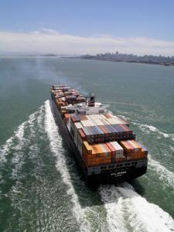
Criticism:
Offers causes but no solutions
Talks to free up trade have been going on for many years; progress is slow.
We know that protectionism is disadvantageous to developing countries but how do we go about putting in place solutions to help solve the problem?
Copyright: Doug Wray, http://www.sxc.hu

Slide 19
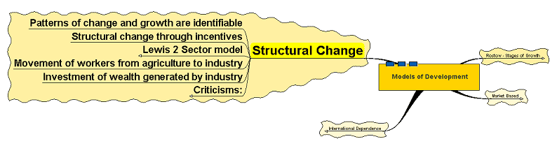
Structural Change

Slide 20
Structural Change
Structural change models focus on the different productivity levels of economies
Process of structural change determines the rate of development
Can such structural changes be accommodated?

Slide 21
Structural Change
Less developed nations – tend to be dominated by primary industries – low value added, difficult to generate wealth and thus sources of investment
Developed nations – diverse economies, high value added, high levels of investment
Structural change can be encouraged by incentives

Slide 22
Lewis 2 Sector model
Agriculture - low value added
Industrial sector - higher productivity and wealth generation
Incentives to encourage workers to migrate from rural economy to urban
Rural workers have very low if not zero marginal productivity
Wage premiums in urban industry 30% above rural wages would encourage migration from rural to urban whilst still allowing profits to be made
Re-investment of profits would lead to a self perpetuating development

Slide 23
Criticisms:
Labour re-allocation not always productive
Wealth not re-invested locally
Wealth goes abroad
Imperfections in the labour market
Importance of complementary policies
by all countries involved

